Slide 1
Probabilistic Programming
Marius Popescu
popescunmarius@gmail.com
2018 - 2019

Slide 2
Hierarchical Models
From PyMC2 to PyMC4 via TFP

Slide 3
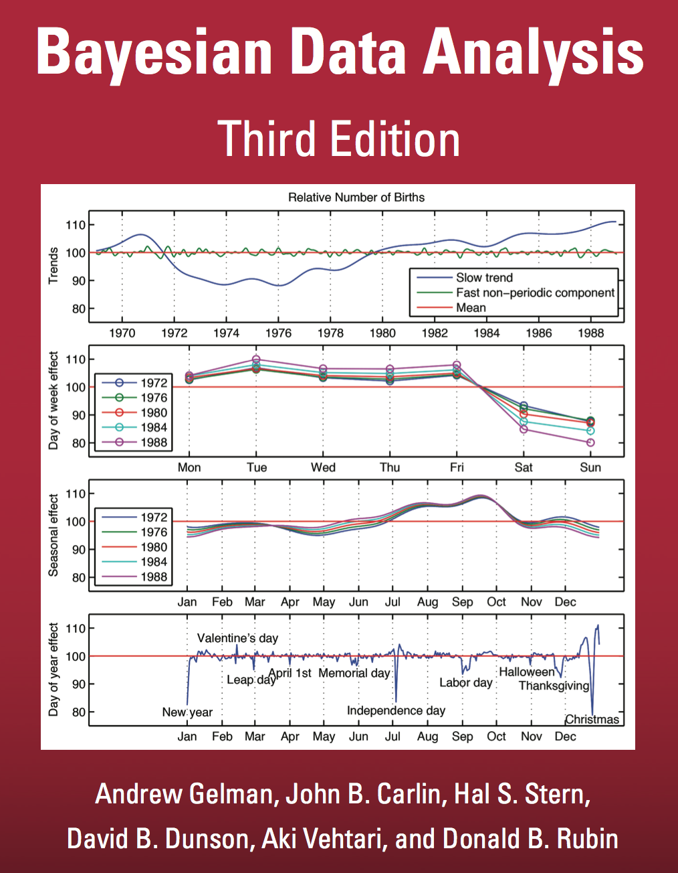
Hierarchical Models

Slide 4

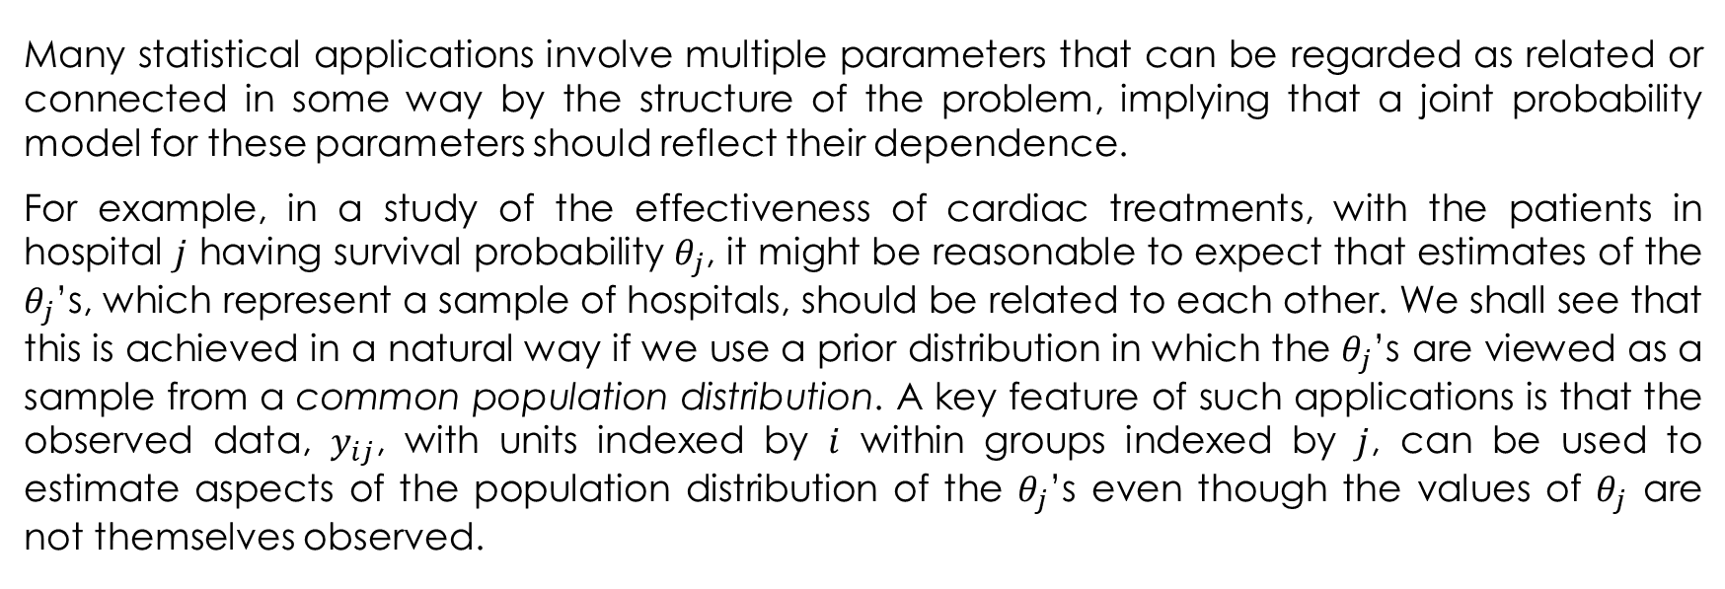
Hierarchical Models
Many statistical applications involve multiple parameters that can be regarded as related or connected in some way by the structure of the problem, implying that a joint probability model for these parameters should reflect their dependence.
For example, in a study of the effectiveness of cardiac treatments, with the patients in hospital $j$ having survival probability $θ_{j}$, it might be reasonable to expect that estimates of the $θ_{j}$’s, which represent a sample of hospitals, should be related to each other. We shall see that this is achieved in a natural way if we use a prior distribution in which the $θ_{j}$’s are viewed as a sample from a common population distribution. A key feature of such applications is that the observed data, $y_{ij}$, with units indexed by $i$ within groups indexed by $j$, can be used to estimate aspects of the population distribution of the $θ_{j}$’s even though the values of $θ_{j}$ are not themselves observed.

Slide 5
Hierarchical Models
It is natural to model such a problem hierarchically, with observable outcomes modeled conditionally on certain parameters, which themselves are given a probabilistic specification in terms of further parameters, known as hyperparameters. Such hierarchical thinking helps in understanding multiparameter problems and also plays an important role in developing computational strategies.

Slide 6
Why Hierarchical Models Matter?
A Cognitive Perspective

Slide 7

Common sense and context affect letter form perception: (i) m vs u and n. (ii) the same line segments are interpreted as N or S depending on occluder positions (iii) perception of the shapes aids the recognition .

Slide 9
Perception as Inference
The properties of the world that we care about - which drive behavior - are not directly provided by sensory input. There are no sensors that measure surface shape, motion of objects, material properties, or object identity. Rather, these properties are entangled among multiple sensor values and must be disentangled to be made explicit.
Importantly, the nature of these disentangling problems is that they are often ill-posed, meaning that there is not enough information provided by the sensory data to uniquely recover the properties of interest. In other words, the various aspects of a scene that are needed to drive behavior can not simply be deduced from sensory measurements. Rather, they must be inferred by combining sensory data together with prior knowledge.

Slide 10
Perception as Inference
Computing a representation of the 2D edges in this image is easy, but understanding what they mean is far more difficult. Note that there are three different types of edges: 1) those due to a change in reflectance (the boundary between q and r), 2) those due to a change in 3D object shape (the boundary between p and q), and 3) those due to the boundary between the object and background.
Adelson, E. H. (2000). Lightness Perception and Lightness Illusions. In M. Gazzaniga (Ed.), The New Cognitive Neurosciences, 2nd Ed. (pp. 339-351): MIT Press.

Slide 11
What do these edges mean?

Slide 12
The Problem of Disentangling
In order to interpret this image, one must understand how illumination, 3D shape, and reflectance interact, and how an object combines with its background in projecting to a 2D image (i.e., occlusion). If an edge is ascribed to be due to a reflectance change, it can not also be due to a shape change (an edge could be due to both, but then the contribution of each of these causes would need to be reduced so that when combined they still match what is in the image). Thus, the computation of reflectance depends on the computation of shape, and vice-versa. And both of these require prior knowledge of what shapes and reflectance changes are likely in order to arrive at a plausible interpretation consistent with the data.

Slide 13
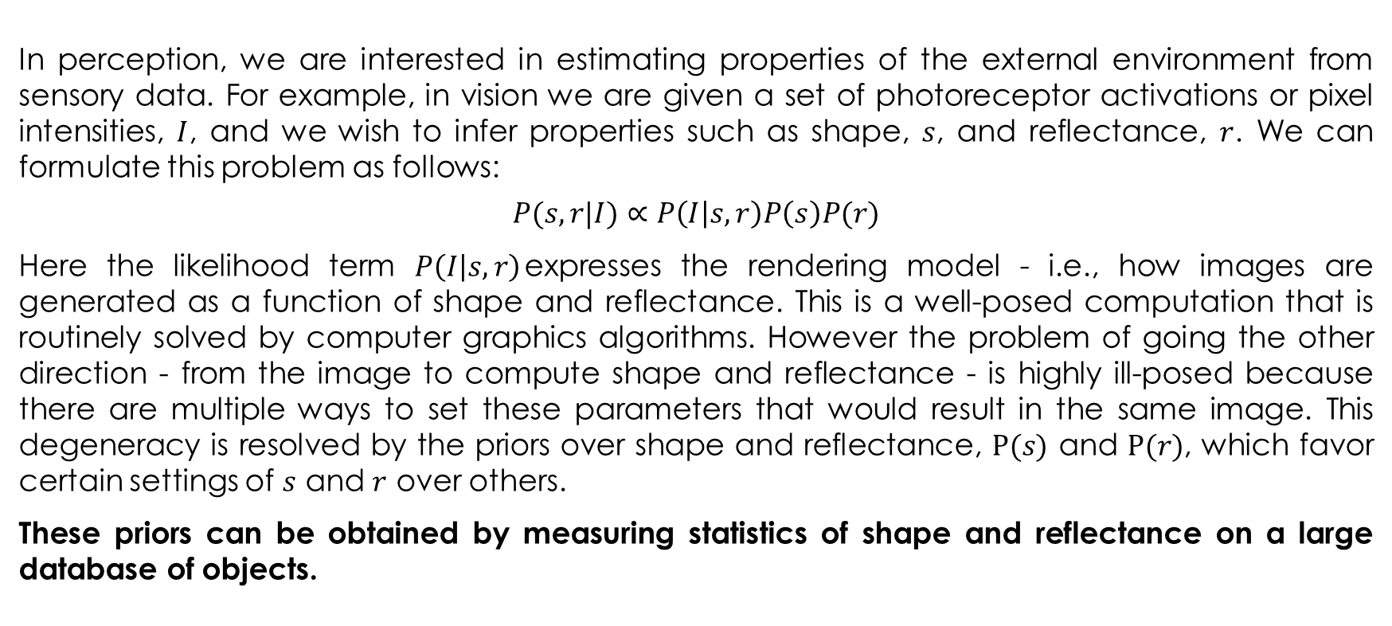
Perception as Inference
In perception, we are interested in estimating properties of the external environment from sensory data. For example, in vision we are given a set of photoreceptor activations or pixel intensities, ﻿$I$﻿, and we wish to infer properties such as shape, ﻿$s$﻿, and reflectance, ﻿$r$. We can formulate this problem as follows:
$$P(s, r|I)∝P\left(I | s, r\right)P\left(s\right)P(r)$$
Here the likelihood term $P\left(I | s, r\right)$expresses the rendering model - i.e., how images are generated as a function of shape and reflectance. This is a well-posed computation that is routinely solved by computer graphics algorithms. However the problem of going the other direction - from the image to compute shape and reflectance - is highly ill-posed because there are multiple ways to set these parameters that would result in the same image. This degeneracy is resolved by the priors over shape and reflectance, $P(s)$﻿ and ﻿$P(r)$﻿, which favor certain settings of $s$﻿ and ﻿$r$ over others.
These priors can be obtained by measuring statistics of shape and reflectance on a large database of objects.

Slide 14
Hierarchical Bayesian Inference in Visual Cortex
The variables represented at each level are inferred from a combination of bottom-up and top-down inputs. Bottom-up inputs enter into the likelihood, while top-down inputs enter into the prior. The two are combined to form the unnormalized posterior, which guides the inference of variables at each level.
Lee, T. S., & Mumford, D. (2003). Hierarchical Bayesian inference in the visual cortex. Journal of the Optical Society of America, A, 20(7), 1434-1448.

Slide 15
The Eight Schools Problem
It has become a classic problem that illustrates the usefulness of hierarchical modeling for sharing information between exchangeable groups.

Slide 16
The Eight Schools Problem
A study was performed for the Educational Testing Service to analyze the effects of special coaching programs for SAT-V (Scholastic Aptitude Test-Verbal) in each of eight high schools. The outcome variable in each study was the score on a special administration of the SAT-V, a standardized multiple choice test administered by the Educational Testing Service and used to help colleges make admissions decisions; the scores can vary between 200 and 800, with mean about 500 and standard deviation about 100. The SAT examinations are designed to be resistant to short-term efforts directed specifically toward improving performance on the test; instead they are designed to reflect knowledge acquired and abilities developed over many years of education. Nevertheless, each of the eight schools in this study considered its short-term coaching program to be very successful at increasing SAT scores. Also, there was no prior reason to believe that any of the eight programs was more effective than any other or that some were more similar in effect to each other than to any other.

Slide 17
The Eight Schools Problem
All students in the experiments had already taken the PSAT (Preliminary SAT), and allowance was made for differences in the PSAT-M (Mathematics) and PSAT-V test scores between coached and uncoached students. In particular, in each school the estimated coaching effect and its standard error were obtained by an analysis of covariance adjustment (that is, a linear regression was performed of SAT-V on treatment group, using PSAT-M and PSAT-V as control variables) appropriate for a completely randomized experiment. A separate regression was estimated for each school. The sample sizes in all of the eight experiments were relatively large, over thirty students in each school. Incidentally, an increase of eight points on the SAT-V corresponds to about one more test item correct.

Slide 18
The Eight Schools Treatment Effects

Slide 19
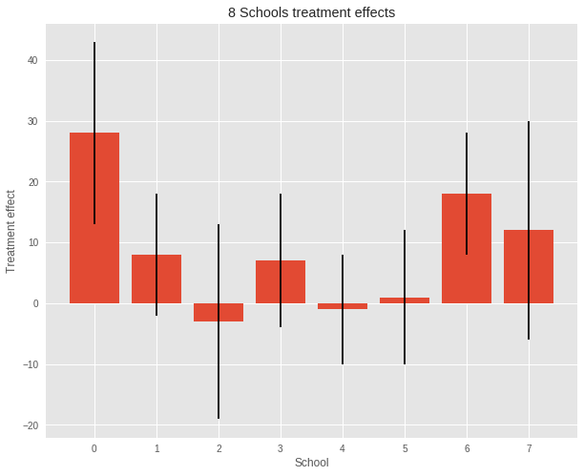
The Eight Schools Treatment Effects

Slide 20
Inferences Based on Nonhierarchical Models and their Problems
Two simpler nonhierarchical methods:
Separate estimates
A pooled estimate

Slide 21
Separate Estimates
A cursory examination may at first suggest that some coaching programs have moderate effects (in the range 18–28 points), most have small effects (0–12 points), and two have small negative effects; however, when we take note of the standard errors of these estimated effects, we see that it is difficult statistically to distinguish between any of the experiments. For example, treating each experiment separately and applying the simple normal analysis in each yields 95% posterior intervals that all overlap substantially.

Slide 22
A Pooled Estimate
The general overlap in the posterior intervals based on independent analyses suggests that all experiments might be estimating the same quantity. Under the hypothesis that all experiments have the same effect and produce independent estimates of this common effect, we could treat the data in Table 5.2 as eight normally distributed observations with known variances. With a noninformative prior distribution, the posterior mean for the common coaching effect is estimated to be 7.7 points with standard error equal to 4.1 which would lead to the 95% posterior interval [−0.5, 15.9], or approximately [8 ± 8].

Slide 23
Inferences Based on Nonhierarchical Models and their Problems
Consider the effect in school A. The effect in school A is estimated as 28.4 with a standard error of 14.9 under the separate analysis, versus a pooled estimate of 7.7 with a standard error of 4.1 under the common-effect model. The separate analyses of the eight schools imply the following posterior statement: ‘the probability is 1/2 that the true effect in A is more than 28.4,’ a doubtful statement, considering the results for the other seven schools. On the other hand, the pooled model implies the following statement: ‘the probability is 1/2 that the true effect in A is less than 7.7,’ which, despite the non-significant χ2 test, seems an inaccurate summary of our knowledge. The pooled model also implies the statement: ‘the probability is 1/2 that the true effect in A is less than the true effect in C,’ which also is difficult to justify given the data.

Slide 24
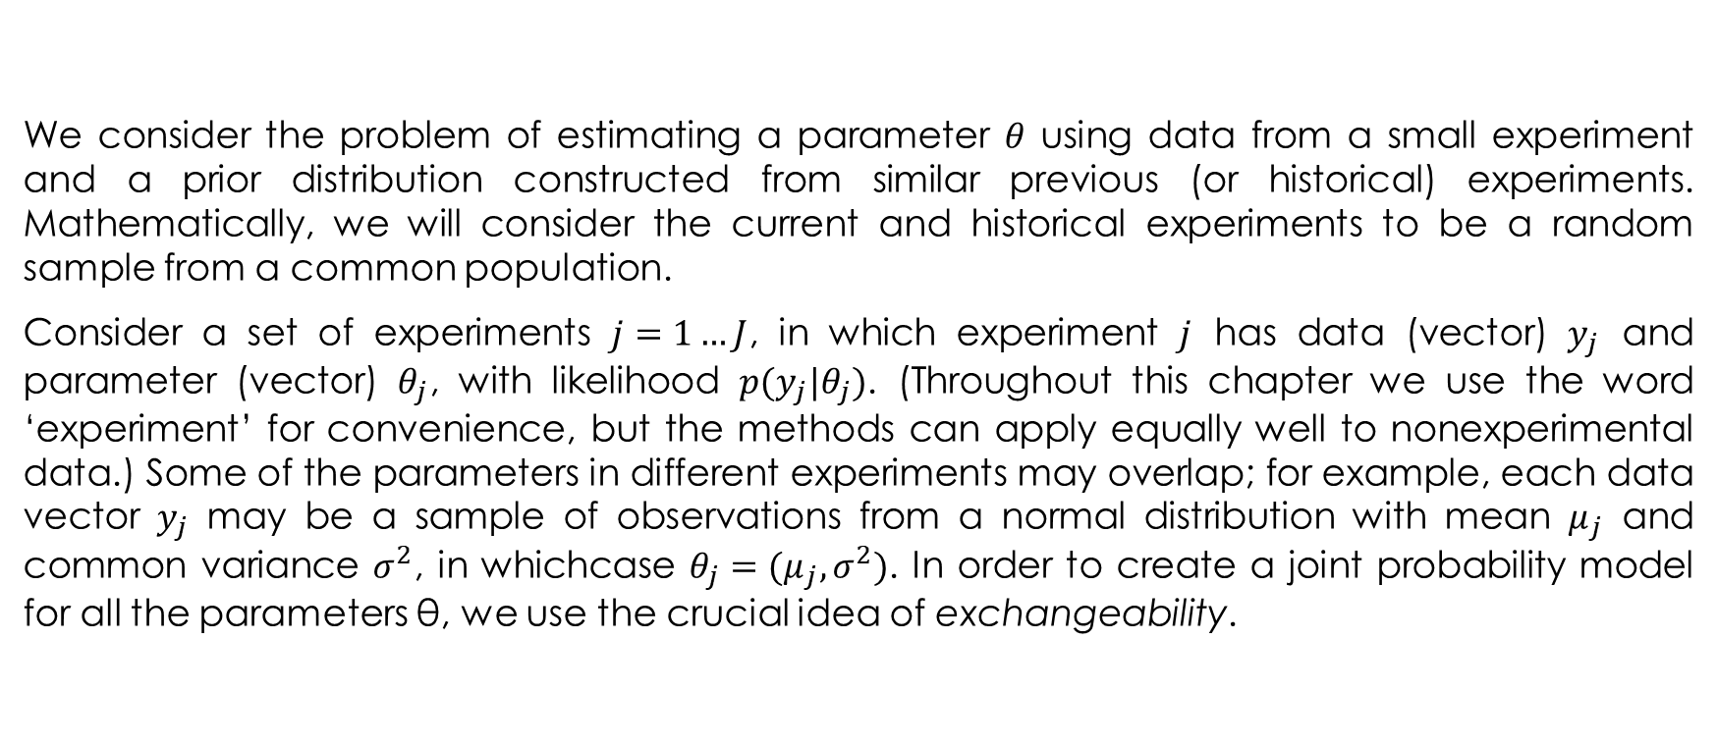
A Hierarchical Normal Model
We consider the problem of estimating a parameter $θ$ using data from a small experiment and a prior distribution constructed from similar previous (or historical) experiments. Mathematically, we will consider the current and historical experiments to be a random sample from a common population.
Consider a set of experiments $j=1…J$, in which experiment $j$ has data (vector) $y_{j}$ and parameter (vector) $θ_{j}$, with likelihood $p(y_{j}|θ_{j})$. (Throughout this chapter we use the word ‘experiment’ for convenience, but the methods can apply equally well to nonexperimental data.) Some of the parameters in different experiments may overlap; for example, each data vector $y_{j}$ may be a sample of observations from a normal distribution with mean $μ_{j}$ and common variance $σ^{2}$, in whichcase $θ_{j}=(μ_{j},σ^{2})$. In order to create a joint probability model for all the parameters θ, we use the crucial idea of exchangeability.

Slide 25
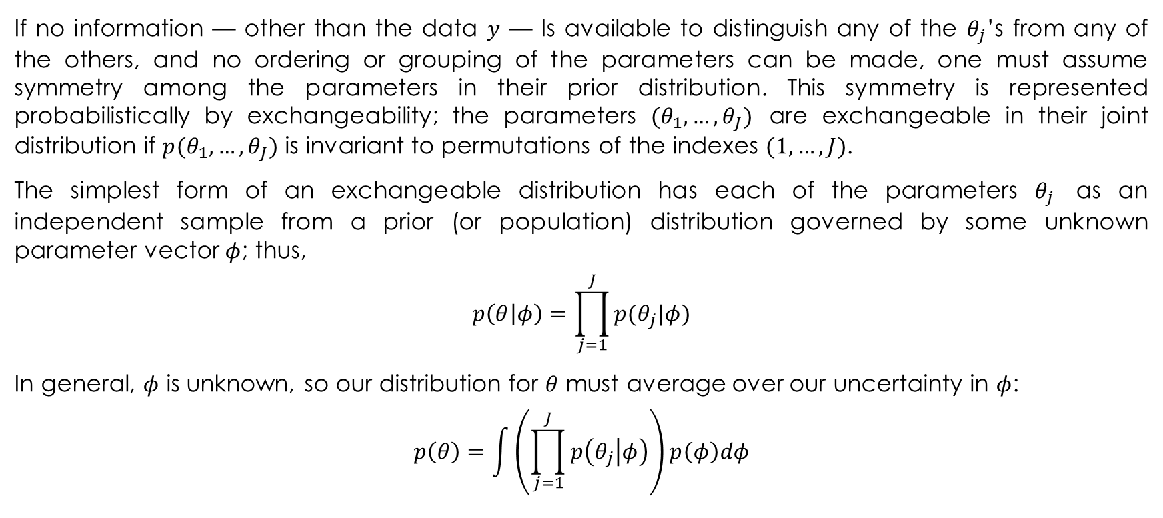
Exchangeability
If no information — other than the data $y$ — Is available to distinguish any of the $θ_{j}$’s from any of the others, and no ordering or grouping of the parameters can be made, one must assume symmetry among the parameters in their prior distribution. This symmetry is represented probabilistically by exchangeability; the parameters $(θ_{1},…,θ_{J})$ are exchangeable in their joint distribution if $p(θ_{1},…,θ_{J})$ is invariant to permutations of the indexes $(1,…,J)$.
The simplest form of an exchangeable distribution has each of the parameters $θ_{j}$ as an independent sample from a prior (or population) distribution governed by some unknown parameter vector $φ$; thus,
$$p\left(θ | φ\right)=\prod_{j=1}^{J}{p(θ_{j}|φ)}$$
In general, $φ$ is unknown, so our distribution for $θ$ must average over our uncertainty in $φ$:
$$p\left(θ\right)=\int{\left(\prod_{j=1}^{J}{p\left(θ_{j} | φ\right)}\right)p\left(φ\right)dφ}$$

Slide 26
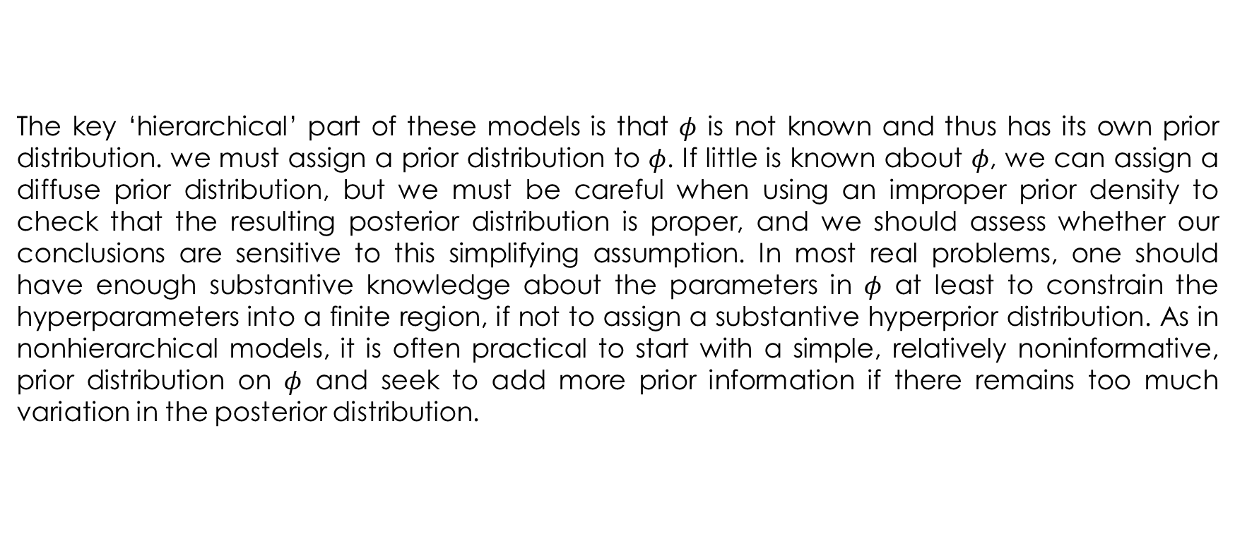
The Bayesian Treatment of the Hierarchical Model
The key ‘hierarchical’ part of these models is that $φ$ is not known and thus has its own prior distribution. we must assign a prior distribution to $φ$. If little is known about $φ$, we can assign a diffuse prior distribution, but we must be careful when using an improper prior density to check that the resulting posterior distribution is proper, and we should assess whether our conclusions are sensitive to this simplifying assumption. In most real problems, one should have enough substantive knowledge about the parameters in $φ$ at least to constrain the hyperparameters into a finite region, if not to assign a substantive hyperprior distribution. As in nonhierarchical models, it is often practical to start with a simple, relatively noninformative, prior distribution on $φ$ and seek to add more prior information if there remains too much variation in the posterior distribution.

Slide 27
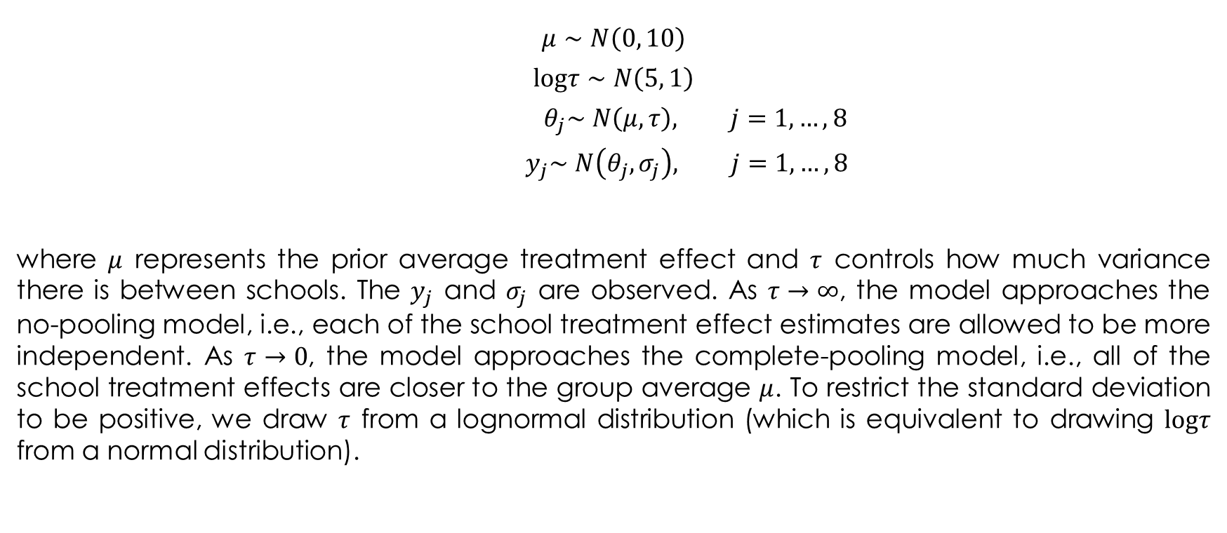
The Eight Schools Hierarchical Model
$$μ∼N\left(0, 10\right)$$
$$\text{log}τ∼N\left(5, 1\right)$$
$${ θ}_{j}∼N\left(μ, τ\right), j=1,…,8$$
$${ y}_{j}∼N\left(θ_{j}, σ_{j}\right), j=1,…,8$$
where $μ$ represents the prior average treatment effect and $τ$ controls how much variance there is between schools. The $y_{j}$ and $σ_{j}$ are observed. As $τ→∞$, the model approaches the no-pooling model, i.e., each of the school treatment effect estimates are allowed to be more independent. As $τ→0$, the model approaches the complete-pooling model, i.e., all of the school treatment effects are closer to the group average $μ$. To restrict the standard deviation to be positive, we draw $τ$ from a lognormal distribution (which is equivalent to drawing $\text{log}τ$ from a normal distribution).

Slide 28
8 Schools in PyMC2
num_schools = 8 # number of schools
treatment_effects = np.array([28, 8, -3, 7, -1, 1, 18, 12], dtype=np.float32) # treatment effects
treatment_stddevs = np.array([15, 10, 16, 11, 9, 11, 10, 18], dtype=np.float32) # treatment SE
treatment_prec = 1. / np.sqrt(treatment_stddevs)
mu = pm.Normal('mu', 0., 0.01)
log_tau = pm.Normal('log_tau', 5., 1.)
@pm.deterministic
def tau(log_tau = log_tau):
return 1. / np.sqrt(np.exp(log_tau))
theta1 = pm.Normal('theta1', mu, tau)
theta2 = pm.Normal('theta2', mu, tau)
theta3 = pm.Normal('theta3', mu, tau)
theta4 = pm.Normal('theta4', mu, tau)
theta5 = pm.Normal('theta5', mu, tau)
theta6 = pm.Normal('theta6', mu, tau)
theta7 = pm.Normal('theta7', mu, tau)
theta8 = pm.Normal('theta8', mu, tau)
y = pm.Normal('y', [theta1, theta2, theta3, theta4, theta5, theta6, theta7, theta8], treatment_prec,
value = treatment_effects, observed = True)
model = pm.Model([mu, log_tau, tau, theta1, theta2, theta3, theta4, theta5, theta6, theta7, theta8, y])
map_ = pm.MAP(model)
map_.fit()
mcmc = pm.MCMC(model)
mcmc.sample(iter=200000, burn=100000, thin=10)

Slide 29
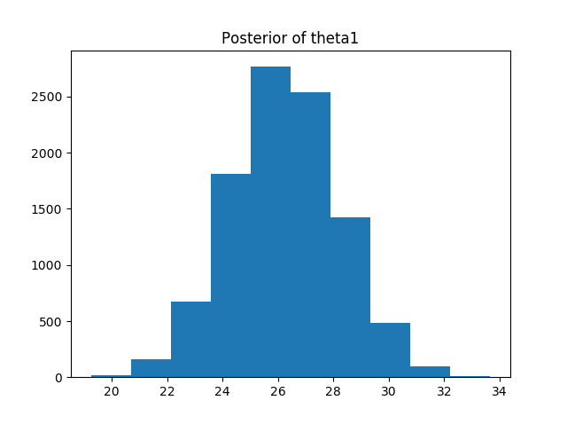
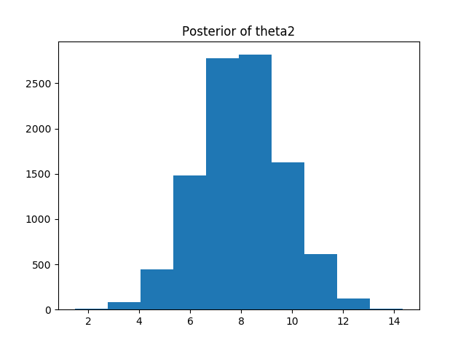
The Results

Slide 30
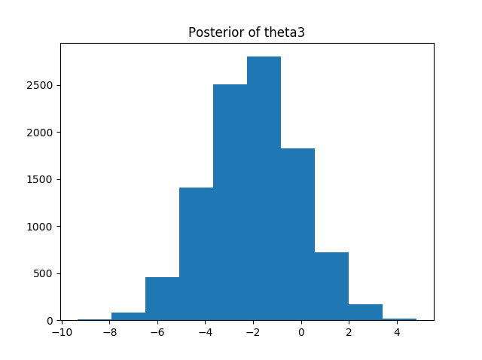
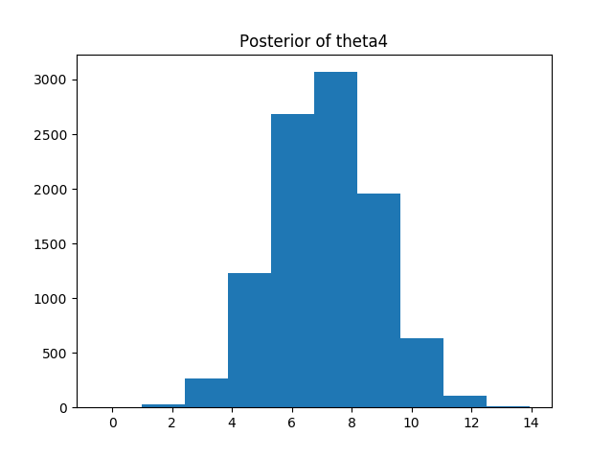
The Results

Slide 31
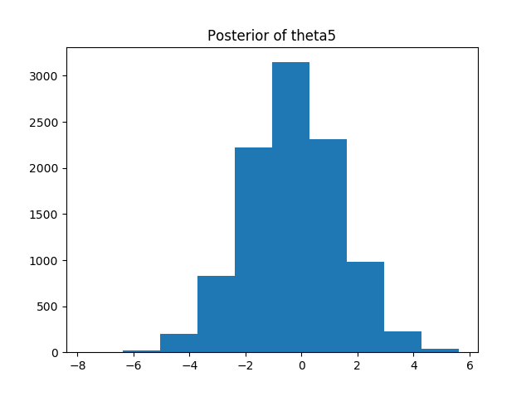
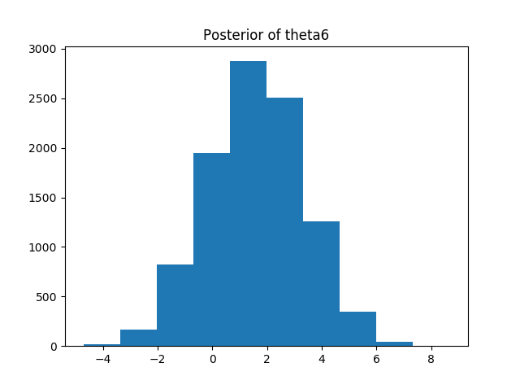
The Results

Slide 32
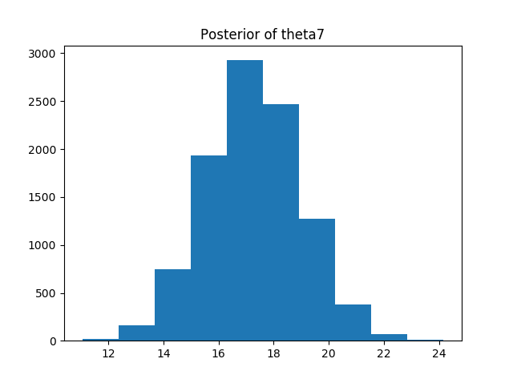
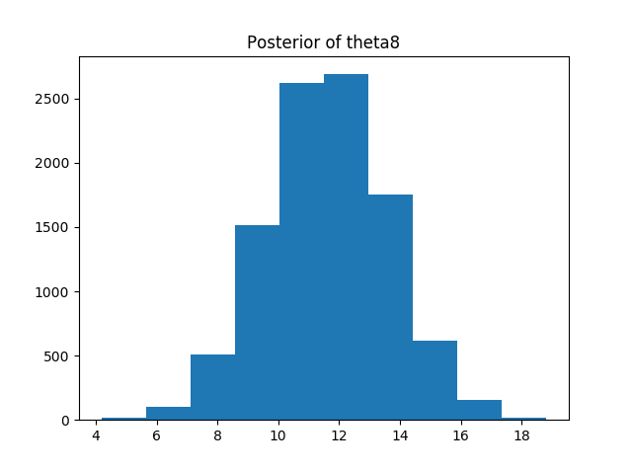
The Results

Slide 33
The Results
print(mcmc.trace('theta1')[:].mean())
print(mcmc.trace('theta2')[:].mean())
print(mcmc.trace('theta3')[:].mean())
print(mcmc.trace('theta4')[:].mean())
print(mcmc.trace('theta5')[:].mean())
print(mcmc.trace('theta6')[:].mean())
print(mcmc.trace('theta7')[:].mean())
print(mcmc.trace('theta8')[:].mean())
26.2473940786
8.0174740141
-1.99846748906
7.10777255222
-0.312653714224
1.57251181192
17.2781573738
11.6265107593

Slide 34
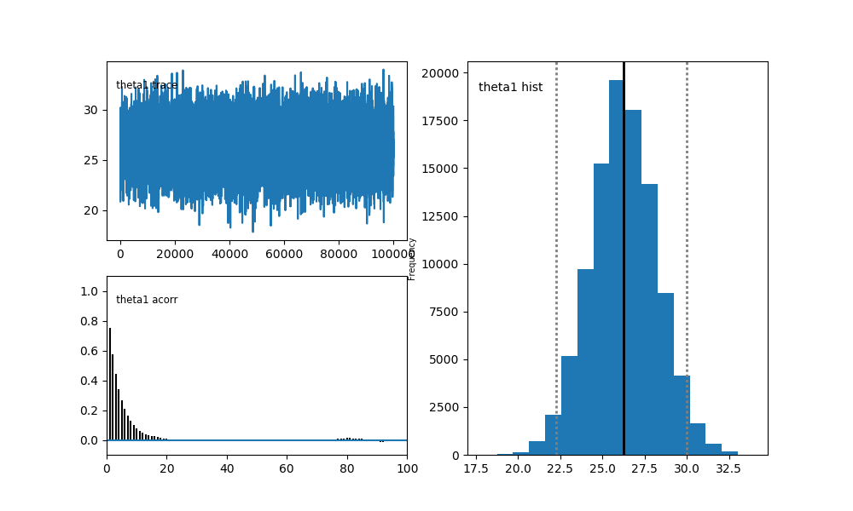
Convergence Diagnostics

Slide 35

Convergence Diagnostics

Slide 36
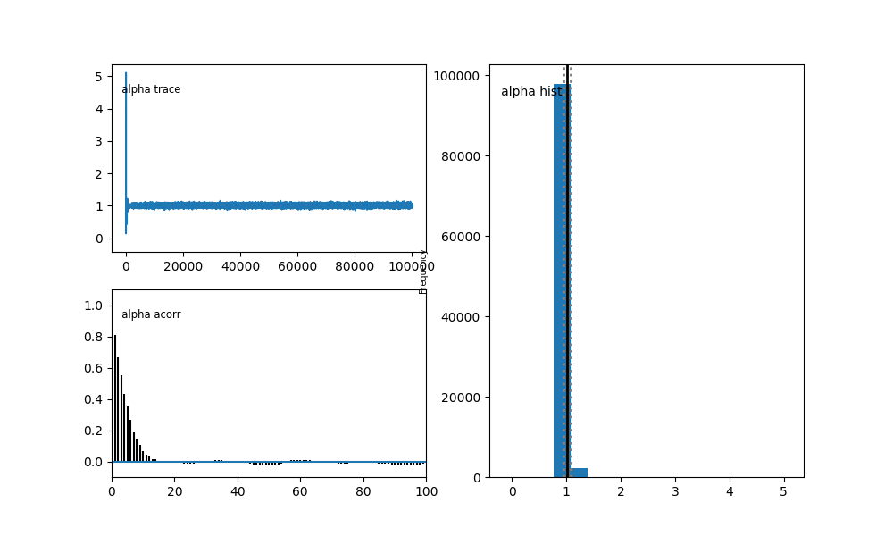
Compare to the convergence in Bayesian simple regression

Slide 37
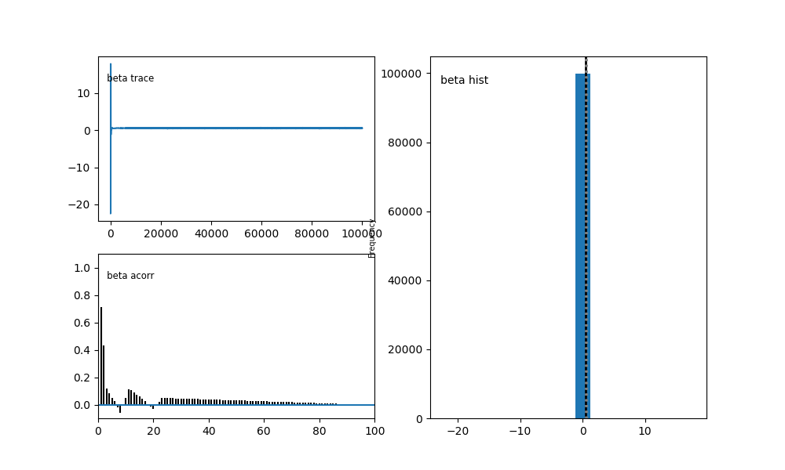
Compare to the convergence in Bayesian simple regression

Slide 38
Hamiltonian Monte Carlo
HMC differs from the Metropolis–Hastings algorithm by reducing the correlation between successive sampled states by using a Hamiltonian evolution between states and additionally by targeting states with a higher acceptance criteria than the observed probability distribution. This causes it to converge more quickly to the absolute probability distribution. It was devised by Simon Duane, A.D. Kennedy, Brian Pendleton and Duncan Roweth in 1987.
There is no free lunch, and Hamiltonian MC has its price: HMC uses not only energy, but also it's gradient. Hence possible applications are limited to the case when gradient exists and can be computed in reasonable time.
The major differences compared to Metropolis-Hastings are:
distances between successive generated points are typically large, so we need less iterations to get representative sampling
'price' of a single iteration is higher, but HMC is still significantly more efficient
Hamiltonian MC in most cases accepts new states
still, HMC has problems with sampling from distributions with isolated local minimums

Slide 39
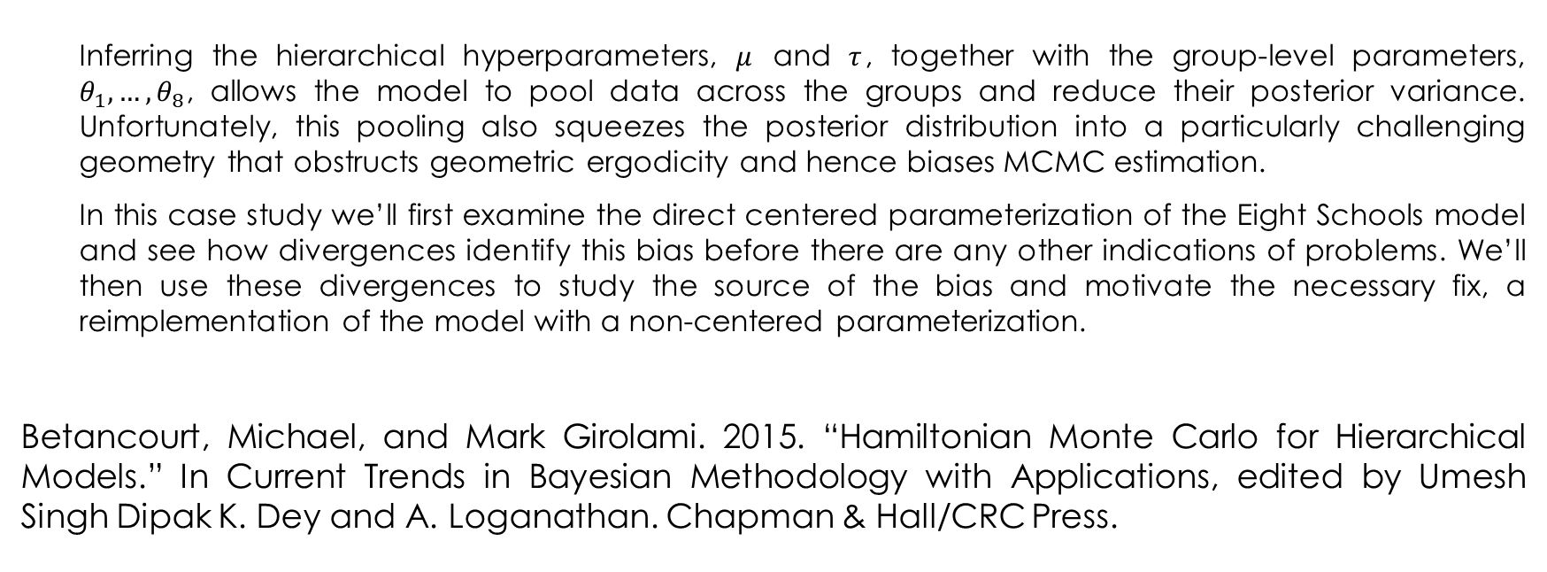
An alternative implementation of the same model
Inferring the hierarchical hyperparameters, $μ$ and $τ$, together with the group-level parameters, $θ_{1},…,θ_{8}$, allows the model to pool data across the groups and reduce their posterior variance. Unfortunately, this pooling also squeezes the posterior distribution into a particularly challenging geometry that obstructs geometric ergodicity and hence biases MCMC estimation.
In this case study we’ll first examine the direct centered parameterization of the Eight Schools model and see how divergences identify this bias before there are any other indications of problems. We’ll then use these divergences to study the source of the bias and motivate the necessary fix, a reimplementation of the model with a non-centered parameterization.
Betancourt, Michael, and Mark Girolami. 2015. “Hamiltonian Monte Carlo for Hierarchical Models.” In Current Trends in Bayesian Methodology with Applications, edited by Umesh Singh Dipak K. Dey and A. Loganathan. Chapman & Hall/CRC Press.

Slide 40

A Non-Centered Eight Schools Implementation
$$μ∼N\left(0, 10\right)$$
$$\text{log}τ∼N\left(5, 1\right)$$
$${{ θ}_{j}}^{′}∼N\left(0 1\right), j=1,…,8$$
$${ θ}_{j}=μ+τ{θ_{j}}^{′}, j=1,…,8$$
$${ y}_{j}∼N\left(θ_{j}, σ_{j}\right), j=1,…,8$$

Slide 41
The Model in TFP
def schools_model(num_schools, treatment_stddevs):
avg_effect = ed.Normal(loc=0., scale=10., name="avg_effect") # `mu` above
avg_stddev = ed.Normal(
loc=5., scale=1., name="avg_stddev") # `log(tau)` above
school_effects_standard = ed.Normal(
loc=tf.zeros(num_schools),
scale=tf.ones(num_schools),
name="school_effects_standard") # `theta_prime` above
school_effects = avg_effect + tf.exp(
avg_stddev) * school_effects_standard # `theta` above
treatment_effects = ed.Normal(
loc=school_effects, scale=treatment_stddevs,
name="treatment_effects") # `y` above
return treatment_effects
log_joint = ed.make_log_joint_fn(schools_model)
def target_log_prob_fn(avg_effect, avg_stddev, school_effects_standard):
return log_joint(
num_schools=num_schools,
treatment_stddevs=treatment_stddevs,
avg_effect=avg_effect,
avg_stddev=avg_stddev,
school_effects_standard=school_effects_standard,
treatment_effects=treatment_effects)
import tensorflow as tf
import tensorflow_probability as tfp
from tensorflow_probability import edward2 as ed

Slide 42
HMC in TFP
states, kernel_results = tfp.mcmc.sample_chain(
num_results=num_results,
num_burnin_steps=num_burnin_steps,
current_state=[
tf.zeros([], name='init_avg_effect'),
tf.zeros([], name='init_avg_stddev'),
tf.ones([num_schools], name='init_school_effects_standard'),
],
kernel=tfp.mcmc.HamiltonianMonteCarlo(
target_log_prob_fn=target_log_prob_fn,
step_size=0.4,
num_leapfrog_steps=3))
avg_effect, avg_stddev, school_effects_standard = states
with tf.Session() as sess:
[
avg_effect_,
avg_stddev_,
school_effects_standard_,
is_accepted_,
] = sess.run([
avg_effect,
avg_stddev,
school_effects_standard,
kernel_results.is_accepted,
])
num_results = 5000
num_burnin_steps = 3000

Slide 43
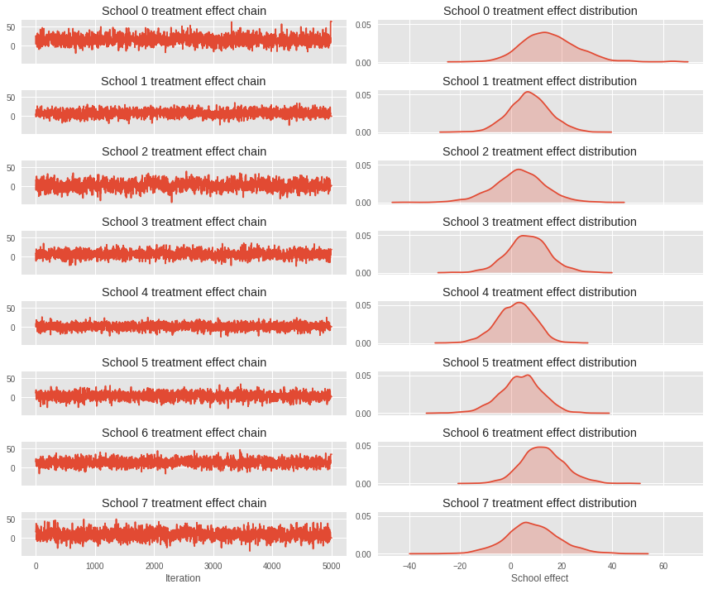
The Results
num_accepted = np.sum(is_accepted_)
print('Acceptance rate:’) print(num_accepted / num_results)
Acceptance rate:
0.6186

Slide 44
The Results
school_effects_samples = (
avg_effect_[:, np.newaxis] +
np.exp(avg_stddev_)[:, np.newaxis] * school_effects_standard_)
print("E[avg_effect] = {}".format(avg_effect_.mean()))
print("E[avg_stddev] = {}".format(avg_stddev_.mean()))
print("E[school_effects_standard] =")
print(school_effects_standard_[:, ].mean(0))
print("E[school_effects] =")
print(school_effects_samples[:, ].mean(0))
print("Inferred posterior mean: {0:.2f}".format(
np.mean(school_effects_samples[:,])))
print("Inferred posterior mean se: {0:.2f}".format(
np.std(school_effects_samples[:,])))

Slide 45
The Results
E[avg_effect] = 6.494342803955078
E[avg_stddev] = 2.436934471130371
E[school_effects_standard] =
[ 0.66298497 0.06529777 -0.26186424 0.01561266 -0.385506 -0.2165112 0.47715753 0.1520656 ]
E[school_effects] =
[15.3593855 7.3573384 3.1578748 6.775903 1.9274986 3.822677 12.657511 8.500975 ]
Inferred posterior mean: 7.44
Inferred posterior mean se: 10.01

Slide 46
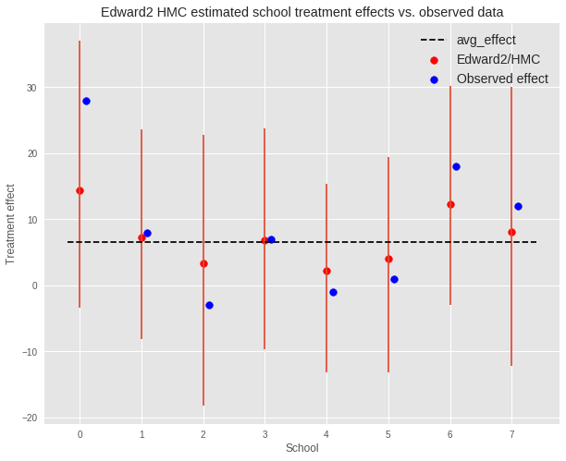
We can observe the shrinkage toward the group avg_effect

Slide 47
Model & Inference Criticism
Assessing how model predictions match the true data
Assessing how data generated from the model matches the true data

Slide 48
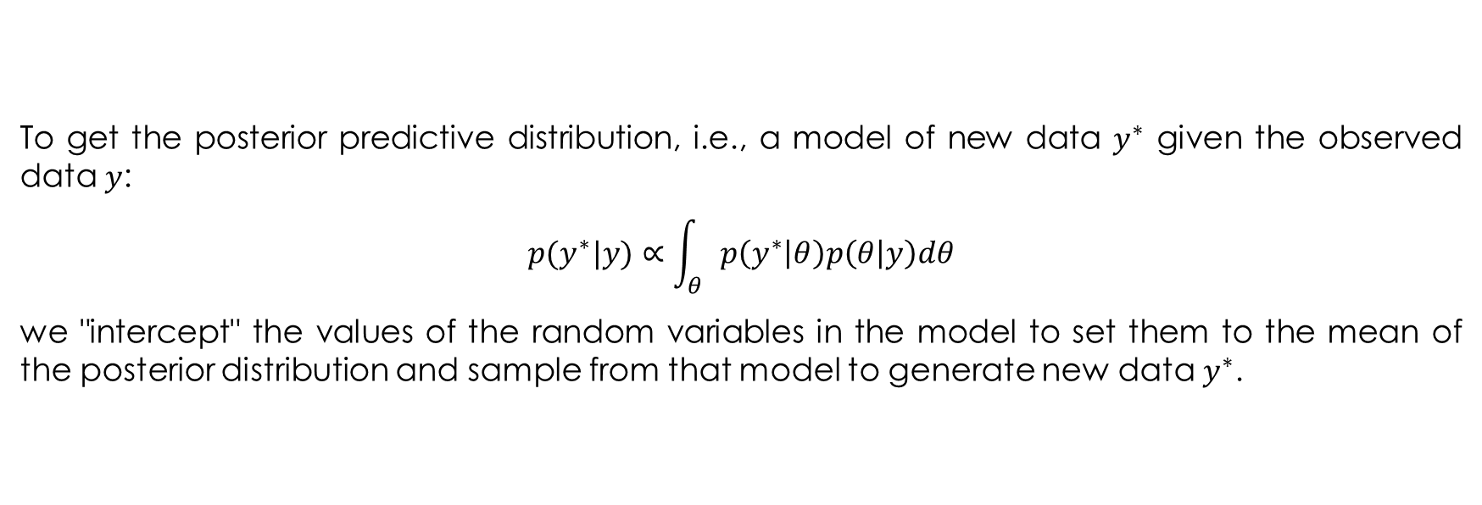
8 Schools Model Criticism
To get the posterior predictive distribution, i.e., a model of new data $y^{∗}$ given the observed data $y$:
$$p(y^{∗}|y)∝\int_{θ}{p\left(y^{∗} | θ\right)p\left(θ | y\right)dθ}$$
we "intercept" the values of the random variables in the model to set them to the mean of the posterior distribution and sample from that model to generate new data $y^{∗}$.

Slide 49
Manipulating Model Computation: Interceptors
An interceptor is a function that acts on another function f and its arguments *args, **kwargs. It performs various computations before returning an output (typically f(*args, **kwargs): the result of applying the function itself). The ed.interception context manager pushes interceptors onto a stack, and any interceptable function is intercepted by the stack. All random variable constructors are interceptable.
In particular, we make predictions with a model learned posterior means rather than with its priors.

Slide 50
Posterior Predictive
def interceptor(rv_constructor, *rv_args, **rv_kwargs):
"""Replaces prior on effects with empirical posterior mean from MCMC."""
name = rv_kwargs.pop("name")
if name == "avg_effect":
rv_kwargs["value"] = np.mean(avg_effect_, 0)
elif name == "avg_stddev":
rv_kwargs["value"] = np.mean(avg_stddev_, 0)
elif name == "school_effects_standard":
rv_kwargs["value"] = np.mean(school_effects_standard_, 0)
return rv_constructor(*rv_args, **rv_kwargs)
with ed.interception(interceptor):
posterior = schools_model(
num_schools=num_schools, treatment_stddevs=treatment_stddevs)
with tf.Session() as sess:
posterior_predictive = sess.run(
posterior.distribution.sample(sample_shape=(5000)))

Slide 51
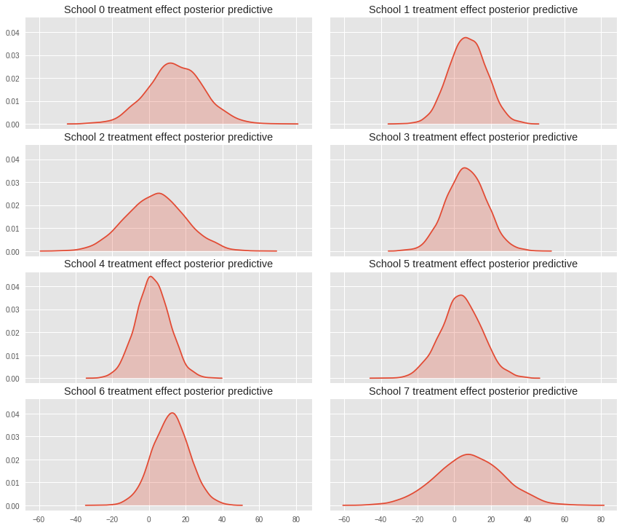
The Results

Slide 52
PyMC4
A Keras for TFP?

Slide 53
8 Schools in PyMC4
import numpy as np
import pymc4 as pm4
import tensorflow as tf # For Random Variable operation
from tensorflow_probability import edward2 as ed # For defining random variables
J = 8 # No. of schools
y = np.array([28., 8., -3., 7., -1., 1., 18., 12.])
sigma = np.array([15., 10., 16., 11., 9., 11., 10., 18.])

Slide 54
8 Schools in PyMC4
pymc4_non_centered_eight = pm4.Model(num_schools=J, y=y, sigma=sigma)
@pymc4_non_centered_eight.define
def process(cfg):
mu = ed.Normal(loc=0., scale=5., name="mu")
log_tau = ed.Normal(
loc=5., scale=1., name="log_tau")
theta_prime = ed.Normal(
loc=tf.zeros(cfg.num_schools),
scale=tf.ones(cfg.num_schools),
name="theta_prime")
theta = mu + tf.exp(
log_tau) * theta_prime
y = ed.Normal(
loc=theta,
scale=np.float32(cfg.sigma),
name="y")
return y
pymc4_non_centered_eight.observe(y=y)

Slide 55
8 Schools in PyMC4
pymc4_trace = pm4.sample(pymc4_non_centered_eight)
pymc4_theta = pymc4_trace['mu'][:, np.newaxis] + np.exp(pymc4_trace['log_tau'])[:, np.newaxis] * pymc4_trace['theta_prime']
print(np.mean(pymc4_theta, axis = 0))
[14.93055 7.3458967 3.091199 6.523052 2.3198733 3.6610856 12.801121 7.5998383]

